Slide 1


Spring Roll AI: Foodbank assistant for Australia
Bridging the gap between food insecurity and available services through intelligent, dignified assistance.

Slide 2
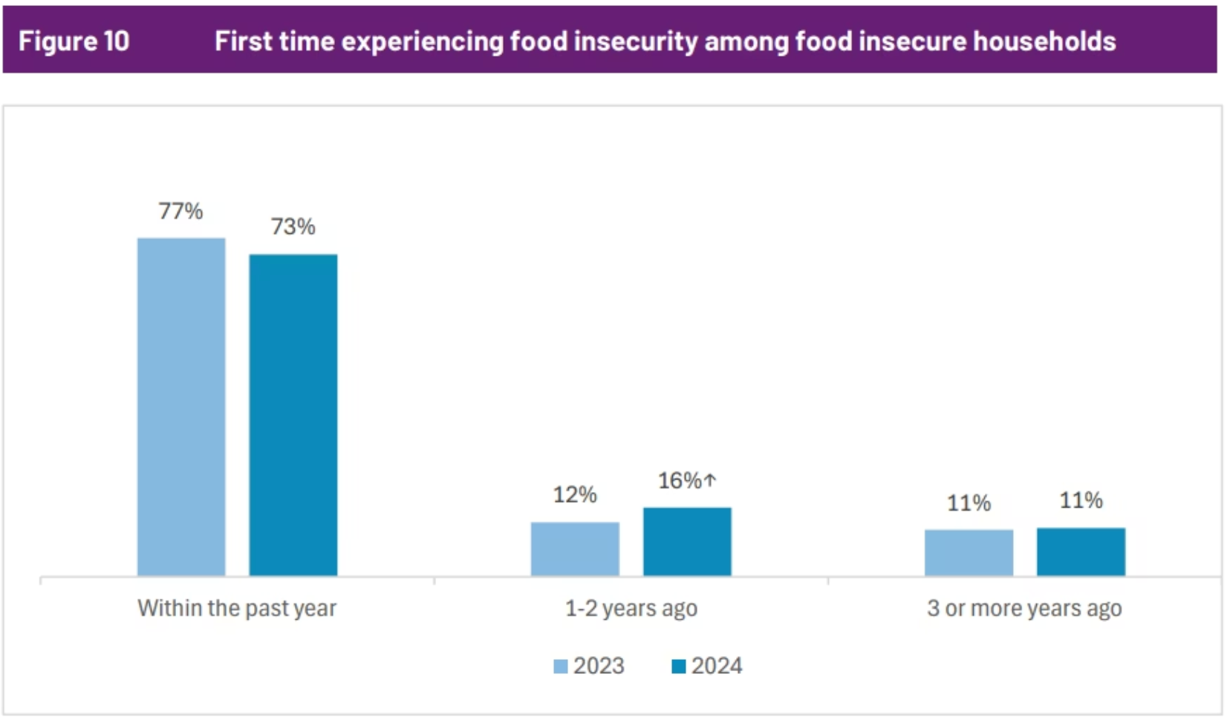
The Hunger Gap in Australia
The Problem
In 2024, for the first time, over 7-in-10 (73%) Australian households experiencing food insecurity in the past 12 months reported being unable to afford enough food. A further 16% first experienced it 1–2 years ago, while 11% have faced it for 3 or more years.
This growing demand requires community services to be scalable and adaptive, ensuring that support can reach households when they need it most.
Source: Foodbank Australia, Foodbank Hunger Report 2024, https://reports.foodbank.org.au/foodbank-hunger-report-2024/?state=au/

Slide 3
Why Aren't People Getting Help?
53%
48%
33%
Don't Know Where
Embarrassment
Eligibility Confusion
Over half of food-insecure Australians don't know where to find available relief services in their communities.
Nearly half feel too ashamed or embarrassed to ask for assistance, creating an invisible barrier to support.
A third of people don't even know if they qualify for services that could help them feed their families.
Our comprehensive data analysis reveals critical information gaps that keep Australians from accessing vital food support. The full access is provided in our attachment.

Slide 4
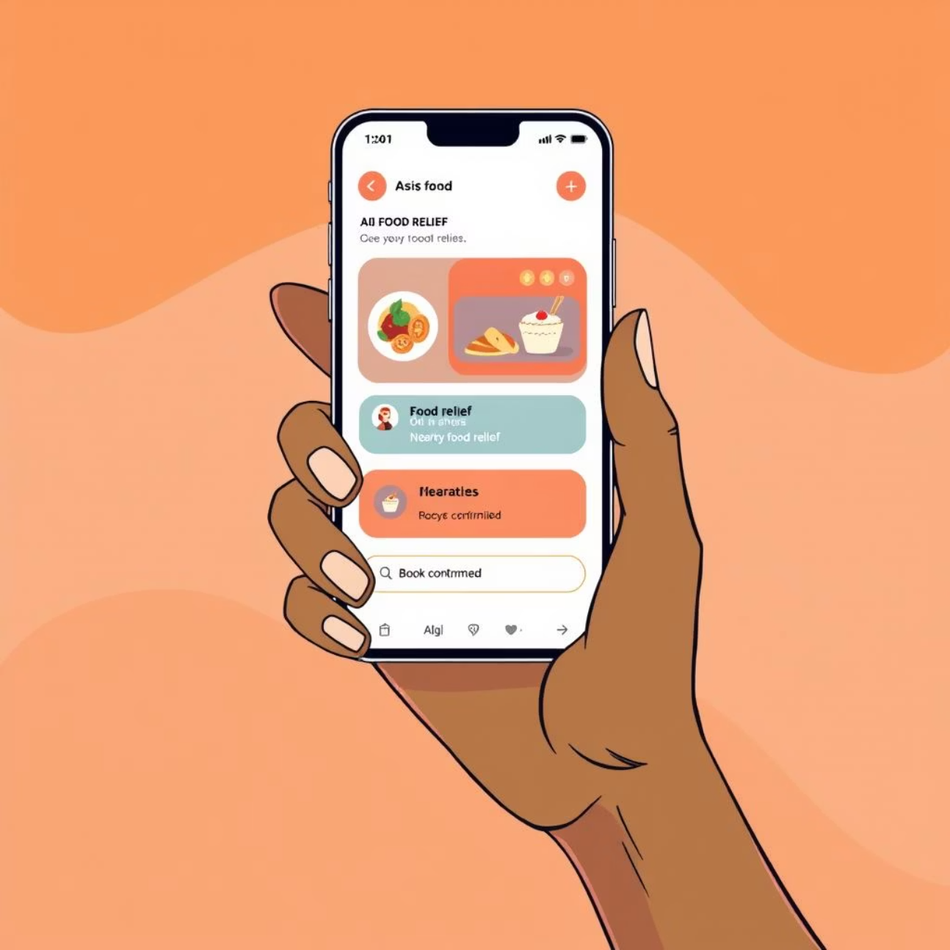
Introducing Spring Roll AI
Your Personal, Anonymous Community Assistant
Finds Food Events
Private Booking
Locates free food distribution events near your location
Books your spot and handles all interactions anonymously
Smart Reminders
Sends timely notifications to ensure you never miss an opportunity

Slide 5
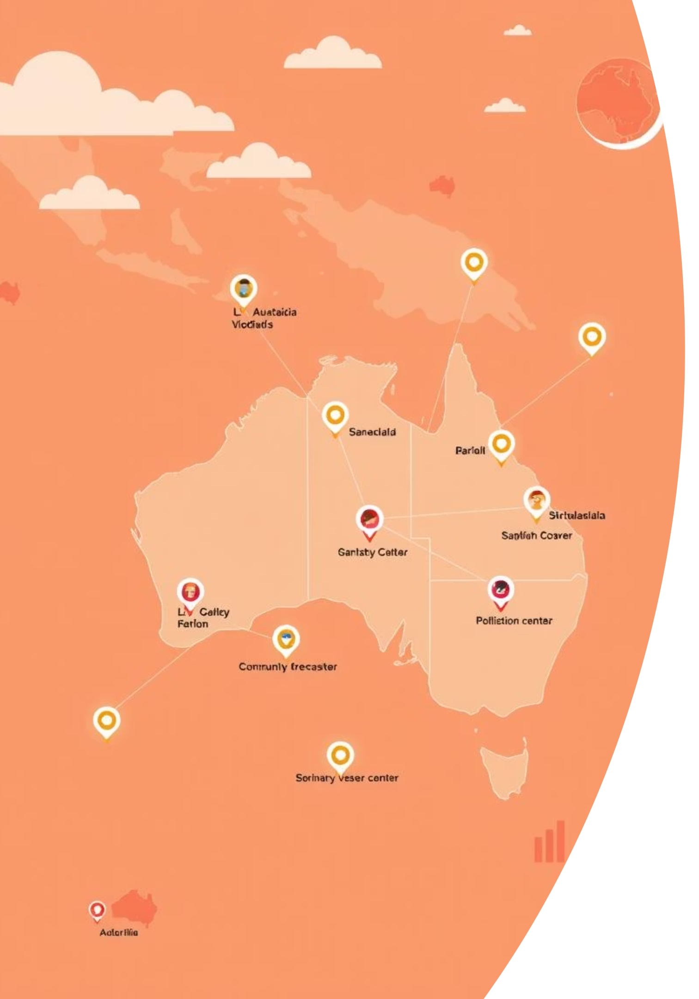
Breaking Down Barriers
"Imagine every Australian having a personal government services assistant in their pocket - breaking down barriers, eliminating bureaucracy, building connected communities."
We're not just solving food insecurity. We're reimagining how government serves its people.

Slide 6

Real Impact on Real Lives
Creating Dignity & Inclusion
Spring Roll AI removes the stigma of seeking help by providing:
Multilingual support for diverse communities
Complete privacy and anonymity
Simple interface that works for all ages
24/7 accessibility when government offices are closed
For thousands like Maria, it's the bridge between need and support.
Spring roll AI agent is live!
"For Maria, a 65-year-old migrant, it meant getting help in her own language without shame."

Slide 7
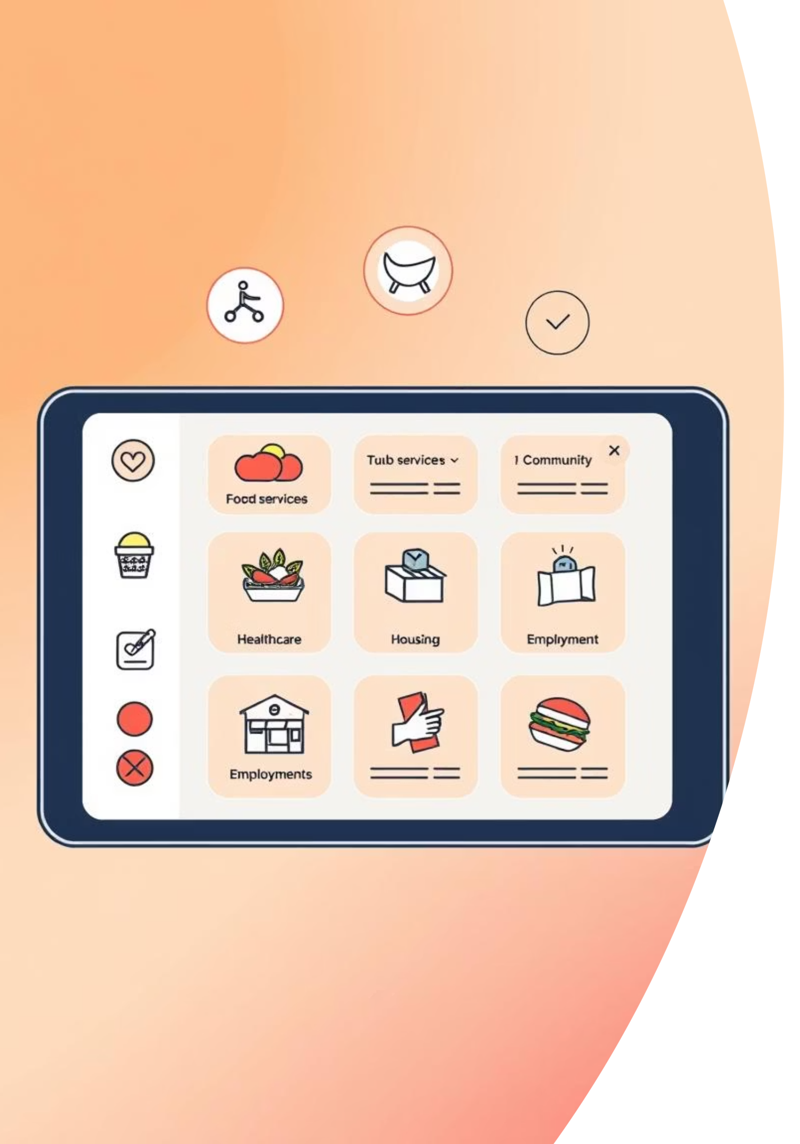




Beyond Food: A Scalable Platform
Food Relief
Connect to food banks, community meals, and emergency supplies
Healthcare
Book appointments and access telehealth services
Housing
Find emergency shelter and housing assistance programs
Job Training
Discover employment resources and skill development
One intelligent assistant, unlimited possibilities for community connection.

Slide 8

Future: Empowering Proactive Community Support
Empowering Councils
Our AI agent learns from each community, predicting seasonal needs and identifying households that require assistance. These insights empower councils to proactively connect residents with tailored support, whether it's local hub information or direct access to relevant services.
Spring Roll AI transforms community support from reactive responses into intelligent, proactive intervention, providing councils with critical intelligence.

Slide 9
References:
Foodbank Australia, Foodbank Hunger Report 2024, https://reports.foodbank.org.au/foodbank-hunger-report-2024/?state=au/

